Slide 1
Talent Development
At HCL

Slide 2
WebElement

Slide 3
Selenium – WebElement
Selenium Web Driver encapsulate a simple form element as an object of WebElement.
There are many forms of WebElement available in any web page such as – Text Field, List, Menu, Drop Down etc.
Once user gets the control of any web page through WebDriver, user should be able to access the Web elements through the Web Driver
There are various techniques (known as Locator Technique) by which the WebDriver identifies the form elements based on the different properties of the Web elements like ID, Name, Class, XPath, Tagname, CSS Selectors, link Text.
Every element in the webpage has an unique address associated with it. WebDriver uses those unique address to locate the WebElement.

Slide 4
WebElement – Locator Technique
Selenium uses locators to find and match the element in the web page.
Locators available in Selenium are
Id
Name
XPATH
CSS
Tag Name
Class name
Link Text
Partial Link Text

Slide 5
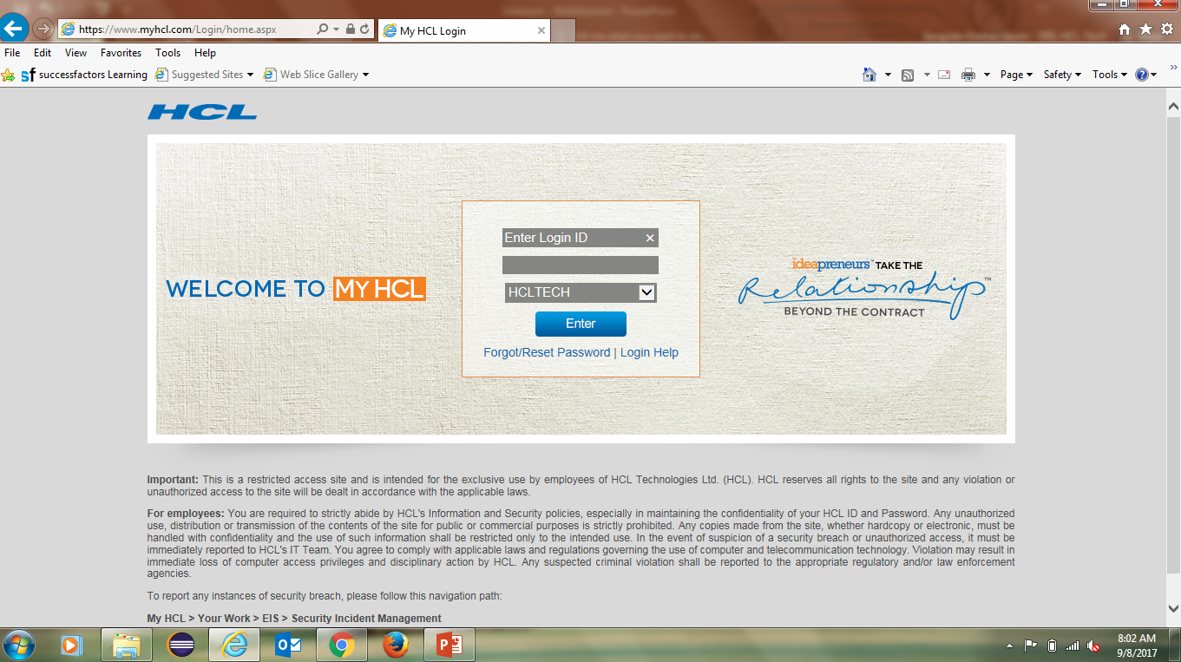
Selenium – WebElement
WebDriver driver = new FirefoxDriver();
driver.get(“https://www.myhcl.com/Login/home.aspx”);
Gets the control of the web page
Driver.findElementBy()

Slide 6
WebElement Methods
Methods | Functionality
sendKeys() | Send character sequence to a text field
clear() | Delete the text in a text field
click() | Clicks the Web Element
isSelected() | Returns True if the WebElement is selected else false
getText() | Returns the text of the WebElement
isEnabled() | Returns True if the WebElement is enabled else false
isDisplayed() | Determine whether or not this element is selected or not.

Slide 7
Code
Download the code from https://github.com/sangramkswain/HCLPuneTraining
File Name – Sessions.zip

